Slide 1
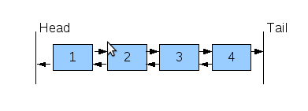
Double-Linked Lists
Front
End

Slide 2
Double-Linked Lists
Limitations of a singly-linked list:
Insertion is convenient only after a referenced node
Removing a node requires a reference to the previous node
We can traverse the list only in the forward direction
How to overcome these limitations?
Double-linked list

Slide 3
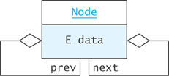
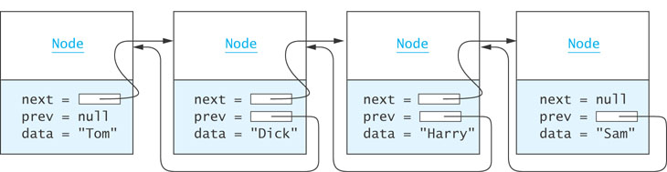
Double-Linked Lists (cont.)

Slide 4
Node Class
class Node {
Object data;
Node next;
Node prev;
public Node(Object dataItem) {
data = dataItem;
}
}

Slide 5
Inserting into a Double-Linked List
from predecessor
sam
Node
Node
to predecessor
next =
= prev
data = "Harry"
next = null
= prev
data = "Sam"
sharon
Node sharon = new Node("Sharon");
sharon.next = sam;
sharon.prev = sam.prev;
sam.prev.next = sharon;
sam.prev = sharon;
Node
next =
= prev
data = "Sharon"

Slide 6
Removing from a Double-Linked List
harry
Node
Node
next =
= prev
data = “Bob"
next =
= prev
data = "Sharon"
Node
harry.prev.next = harry.next
harry.next.prev = harry.prev
next =
= prev
data = "Harry"

Slide 7
A Double-Linked List Class
A double-linked list object has data fields:
front (a reference to the first list Node)
end (a reference to the last list Node)
size
LinkedList
front =
end =
size =

Slide 8

Implementation of a Double-Linked List Class

Slide 9
LinkedList
/** Class LinkedList implements a double linked list. */
public class MyLinkedList {
// Data Fields
Node front;
Node end;
int size;
. . .

Slide 10
Add Method
Obtain a reference, nodeRef, to the node at position index
Insert a new Node n before the node referenced by nodeRef
/** Add an item at the specified index.
@param index The index at which the node is to be inserted
@param n The node to be inserted
Returns true if successful, false
otherwise
*/
public boolean add(int index, Node n) {
}
Notes:
It is not necessary to declare a local ListIterator; the method call listIterator returns an anonymous ListIterator object

Slide 11
Get Method
Obtain a reference, nodeRef, to the node at position index
Return the contents of the Node referenced by nodeRef
/** Get the element at position index.
@param index Position of item to be retrieved
@return The item at index
*/
public String get(int index) {
}

Slide 12
Other Add and Get Methods
public void addFirst(String item) {
add(0, item);
}
public void addLast(String item) {
add(size, item);
}
public E getFirst() {
return front.data;
}
public E getLast() {
return end.data;
}

Slide 13
The hasNext()Method
tests to see if next is null
public boolean hasnext() {
return next != null;
}

Slide 14
Previous Methods
public boolean hasPrevious() {
return prev != null;
}
public Object previous() {
Node ans;
if (!hasPrevious()) {
return null;
}
if (next == null) { // Iterator past the last element
next = end;
}
else {
next = next.prev;
}
ans = next;
index--;
return lastItemReturned.data;
}

Slide 15
The Add Method
4 cases to address:
Add to an empty list
Add to the front of the list
Add to the end of the list
Add to the middle of the list

Slide 16
Adding to an Empty List
LinkedList
Node
front = null
end = null
size = 3
next =
null = prev
data = "Tom"
(after insertion)
1
if (front == null) {
front = new Node(obj);
end = front;
}
...
size++
ListIter
next = lastItemReturned = null
index = 0
1

Slide 17
Adding to the Front of the List
ListIter
next = lastItemReturned = null
index = 0
1
Node
Node
Node
next =
null = prev
data = "Tom"
next =
= prev
data = "Harry"
next = null
= prev
data = "Sam"
LinkedList
front = null
end = null
size = 3
4
if (next == front) {
Node newNode = new Node(obj);
newNode.next = next;
next.prev = newNode;
front = newNode;
}
...
size++;
index++;
Node
next = null
null = prev
data = "Ann"
newNode

Slide 18
Adding to the End of the List
ListIter
next = null lastItemReturned = null
index = 2
3
Node
Node
Node
next =
prev = null
data = "Tom"
next =
= prev
data = "Ann"
next = null
= prev
data = "Sam"
LinkedList
front = null
end = null
size = 3
4
if (next == null) {
Node newNode = new Node(obj);
end.next = newNode;
newNode.prev = end;
end = newNode
}
...
size++;
index++;
Node
next = null
null = prev
data = "Bob"
newNode

Slide 19
Adding to the Middle of the List
ListIter
next = null lastItemReturned = null
index = 1
2
Node
Node
Node
next =
prev = null
data = "Tom"
next =
= prev
data = "Ann"
next = null
= prev
data = "Sam"
LinkedList
front = null
end = null
size = 3
4
Node
else {
Node newNode = new Node(obj);
newNode.prev = next.prev;
next.prev.next = newNode;
newNode.next = next;
next.prev = newNode;
}
...
size++;
index++;
next = null
null = prev
data = "Bob"
newNode

